Slide 1
THIS and objects

Slide 2
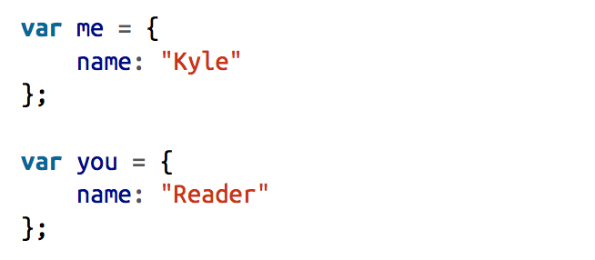
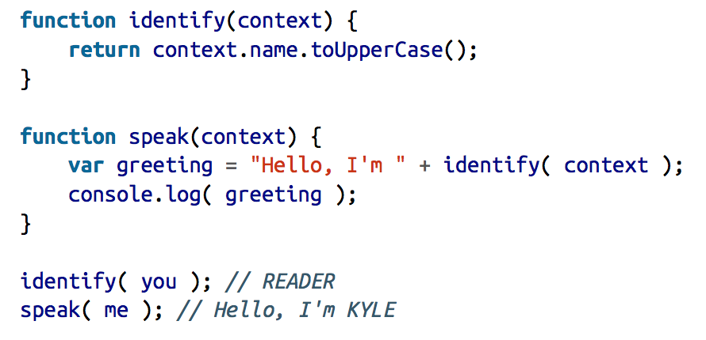
Without this

Slide 3
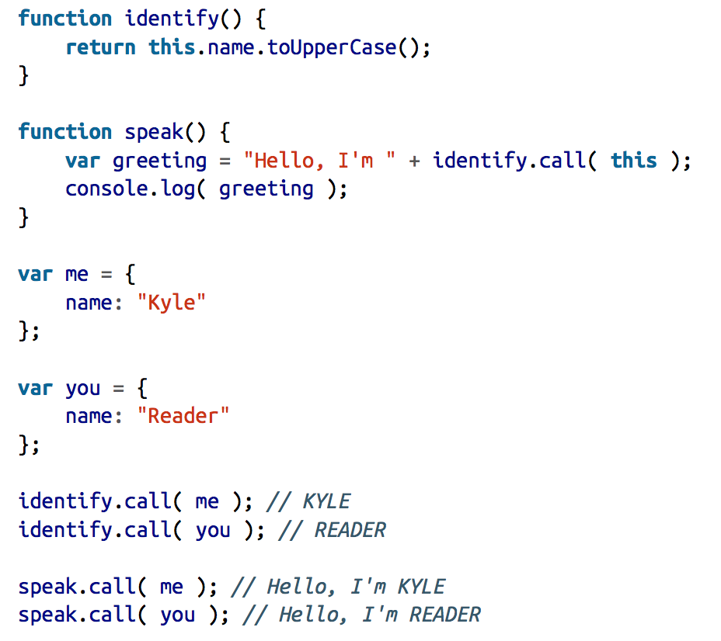
With this

Slide 4
Important
This is not the reference to the function itself
This is not the reference to the function lexical scope
This is not author-timed, it not depends on where you declared a function
This is run-timed, it depends on how and where you call a function
This is more connected with the call-site (call-stack)

Slide 5
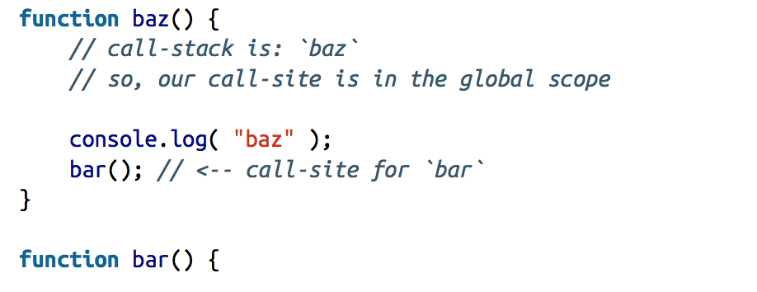
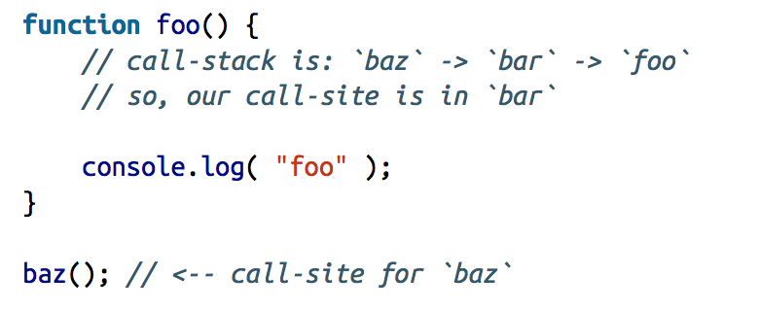
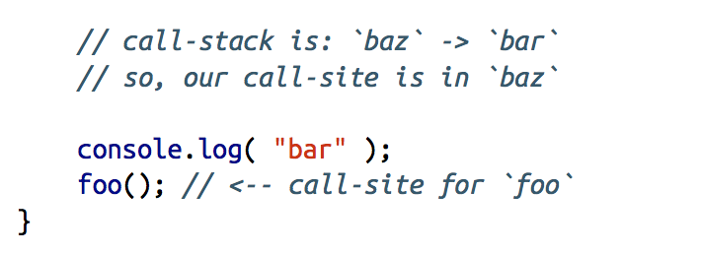
Call-site and call-stack

Slide 6
4 Rules for this binding
Default binding
Implicit binding
Explicit binding
“new” binding

Slide 7
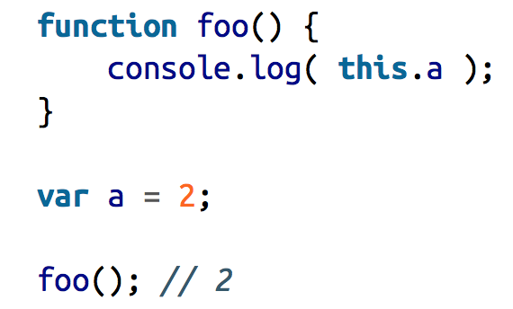
Default binding (non strict mode)

Slide 8
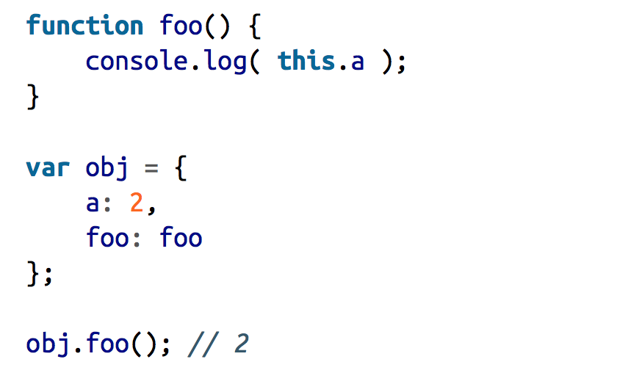
Implicit binding Ex1

Slide 9
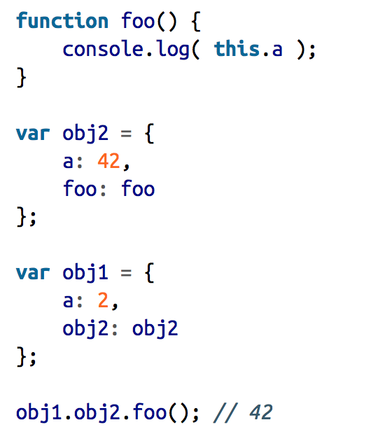
Implicit binding Ex2

Slide 10
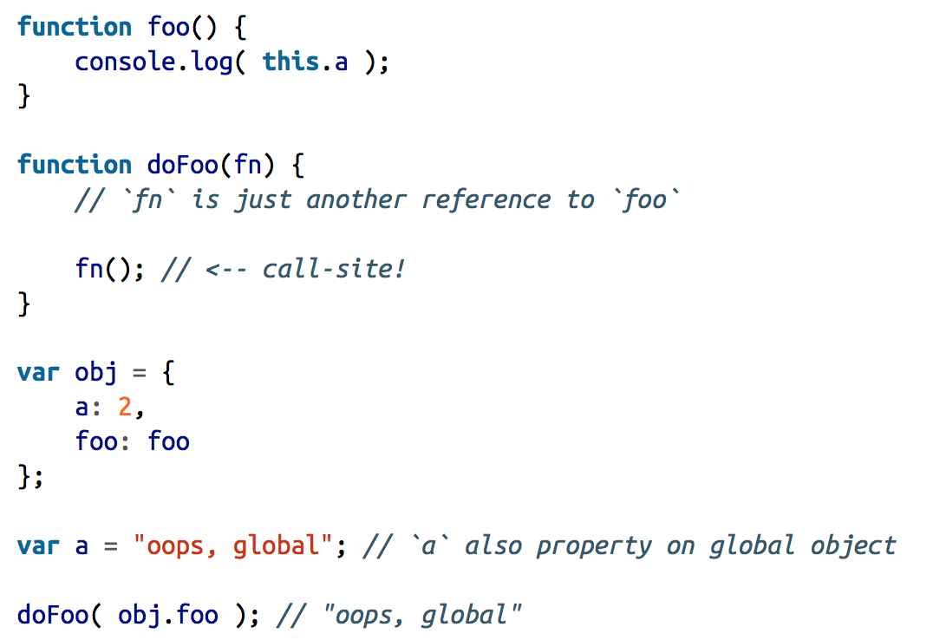
Pay attention to call site

Slide 11
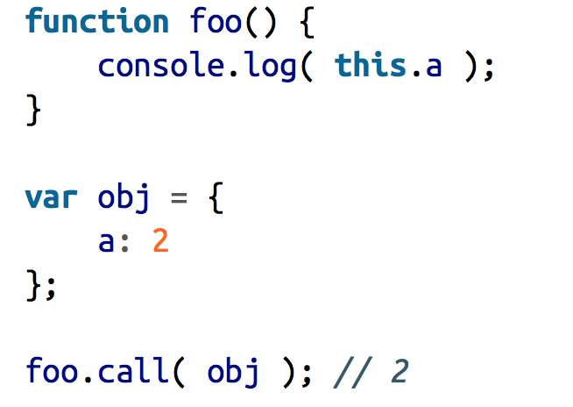
Explicit biding with call and apply

Slide 12
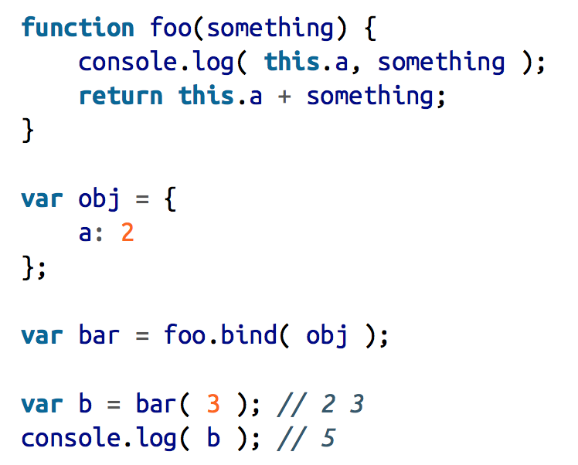
Explicit binding with BIND (From ES5)

Slide 13
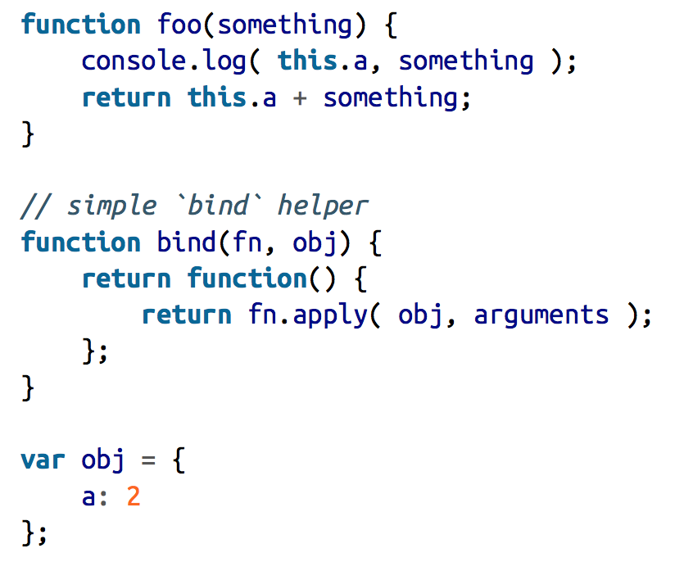
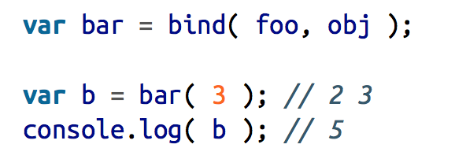
Your own bind pattern

Slide 14


New binding
And guess what .. This chunk of code will not create an actual new instance in JS

Slide 15
How does new works?
A brand new object is created (aka constructed) out of thin air.
The newly constructed object is [[Prototype]]-linked.
The newly constructed object is set as the this binding for that function call.
Unless the function returns its own alternate object, the new-invoked function call will automatically return the newly constructed object.

Slide 16
Who’s stronger?
Explicit binding with our own bind utility
“new”
Explicit binding with call, apply and bind ES5
Implicit binding
Default binding

Slide 18
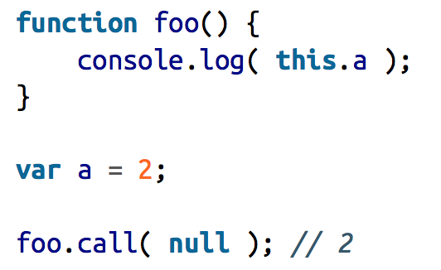
Binding exception n1 (null as this)
If you pass null or undefined as a this binding parameter to call, apply, or bind, those values are effectively ignored, and instead the default binding rule applies to the invocation:

Slide 19
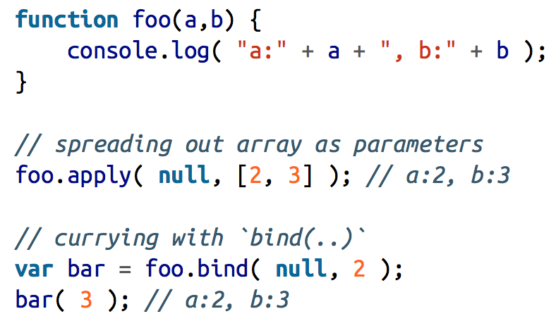
Why pass null to apply?

Slide 20
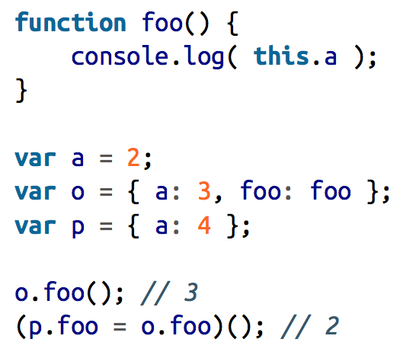
Binding exception n2 (indirection)

Slide 21
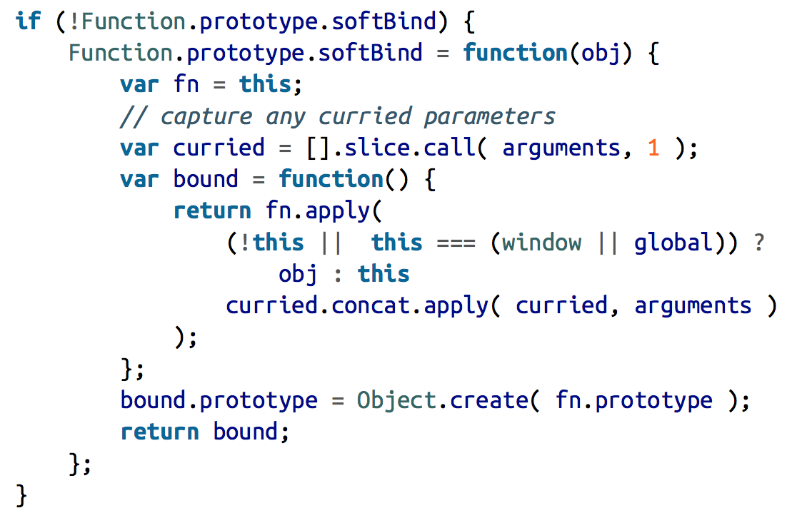
Soft binding utility

Slide 22
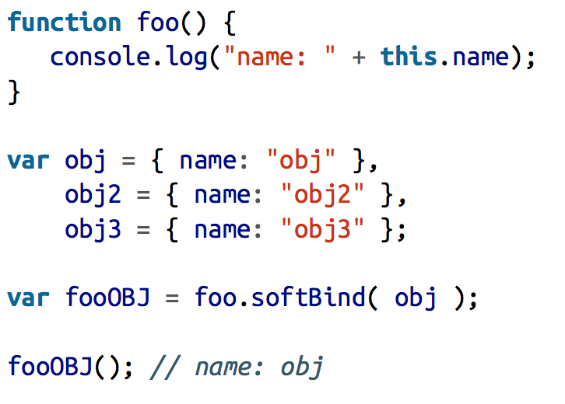
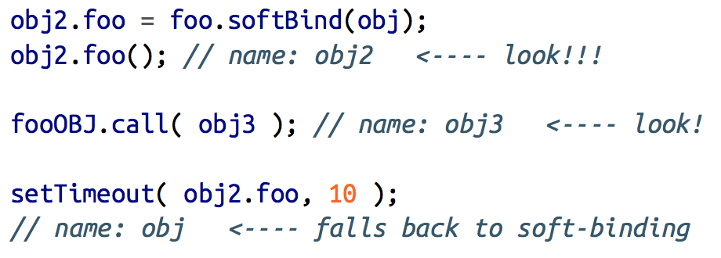
Soft binding example

Slide 23
Arrow functions (it’s all about this)

Slide 24
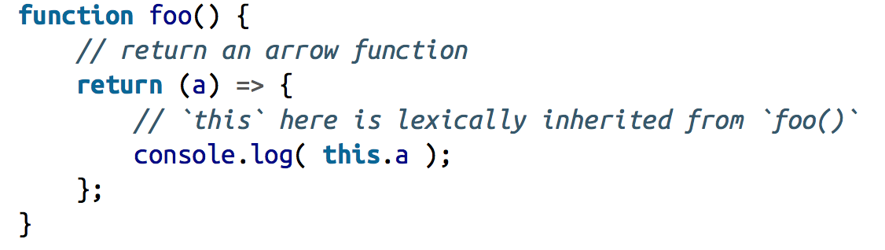
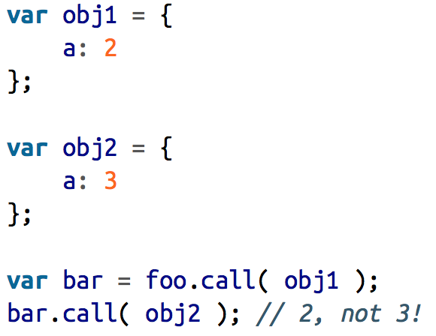
Arrow function example

Slide 25
Don’t forget
Called with new? Use the newly constructed object.
Called with call or apply (or bind)? Use the specified object.
Called with a context object owning the call? Use that context object.
Default: undefined in strict mode, global object otherwise.
Arrow functions will use / borrow the context where they were declared

Slide 26
Guess what .. We will talk about JS objects (ba-dum-tss)

Slide 27
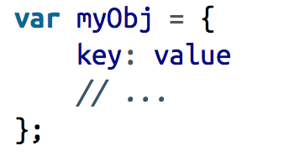
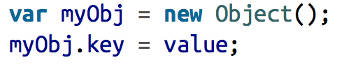
Literal vs Constructed form
Literal
Constructed

Slide 28
Some generalizations
Object is one of the primitive types in JS
null is not an object, typeof null will return “object”, but this is a bug in JS core
There are some subtypes of object (String, Number, Boolean, Date, RegExp, Error, Function, , array) that are called complex primitives

Slide 29
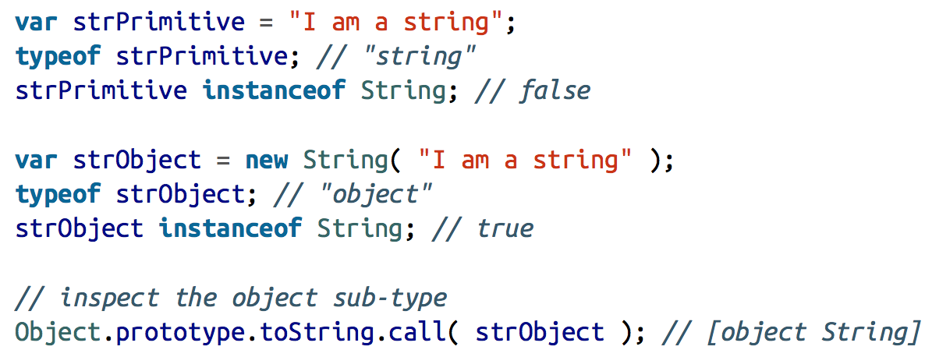
Complex primitives are not primitives

Slide 30
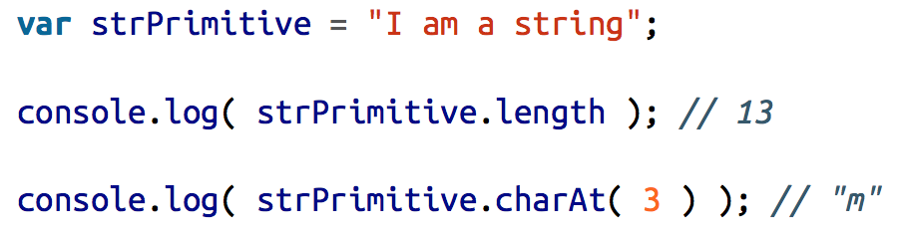
Then how this work?

Slide 31
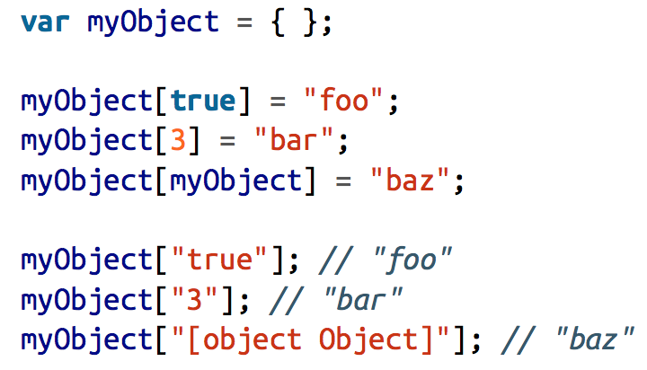
Property names

Slide 32
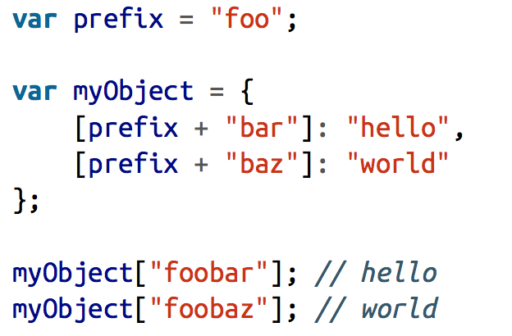
Computed property names (ES6)

Slide 33
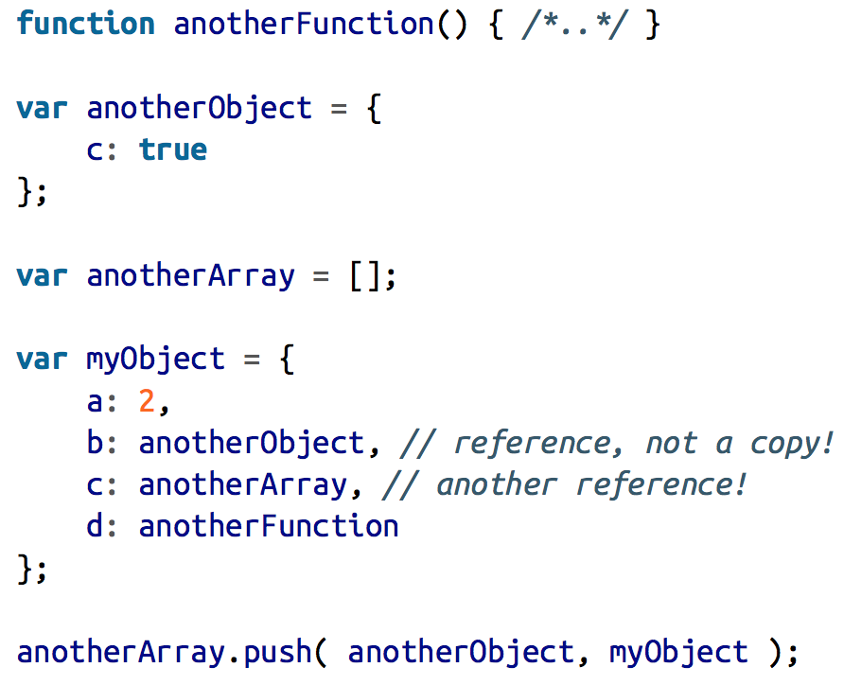
Duplicating the objects?

Slide 34
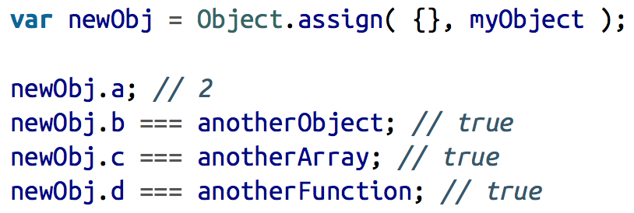
Well known duplication methods
JSON approach
ES6 Assign approach

Slide 35
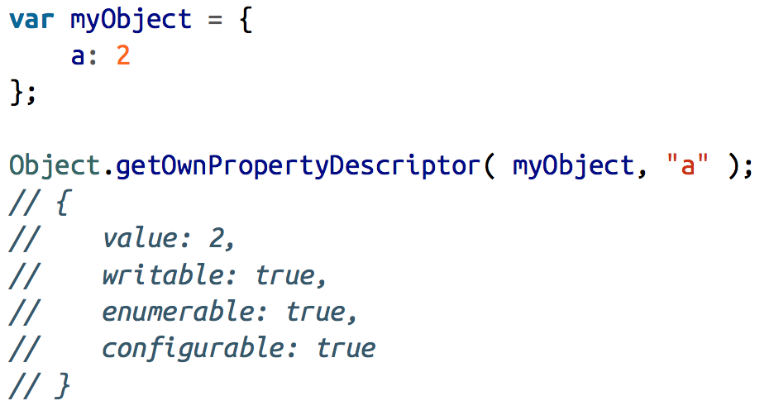
Property descriptor (ES5)

Slide 36
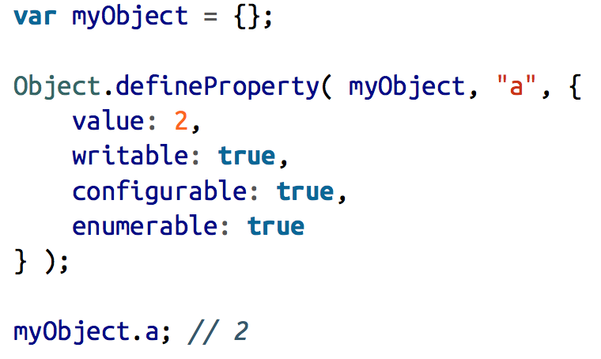
Another way to define a property

Slide 37
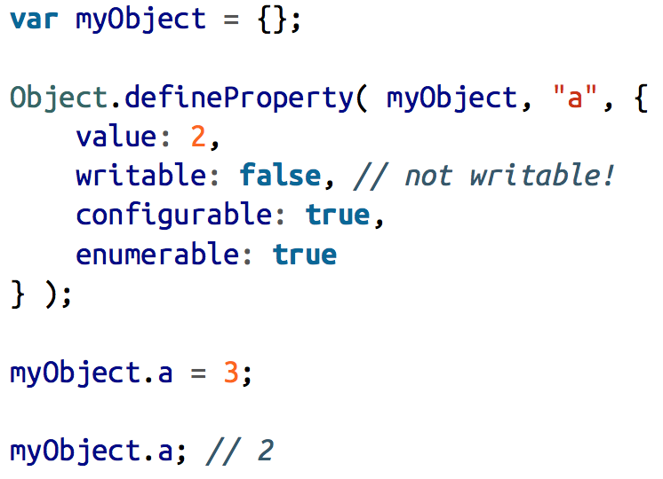
Writable

Slide 38
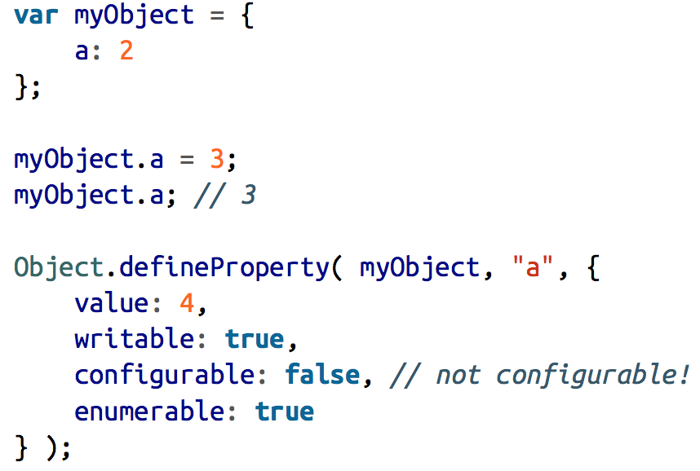
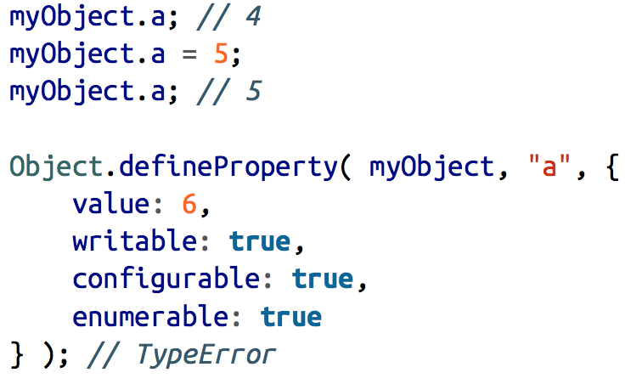
Configurable

Slide 39
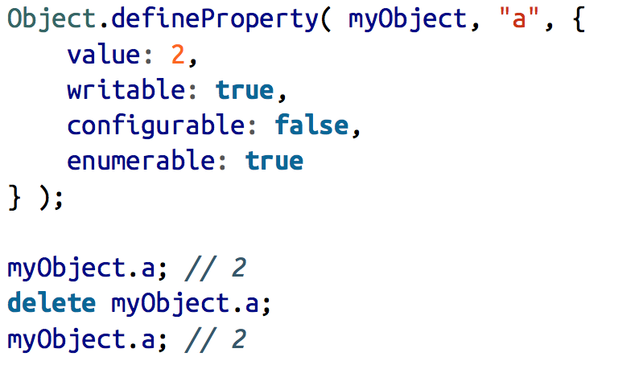
Configurable – More info
There’s a nuanced exception to be aware of: even if the property is already configurable: false, writable can always be changed from true to false without error, but not back to true if already false.
Another thing configurable: false prevents is the ability to use the delete operator to remove an existing property

Slide 40
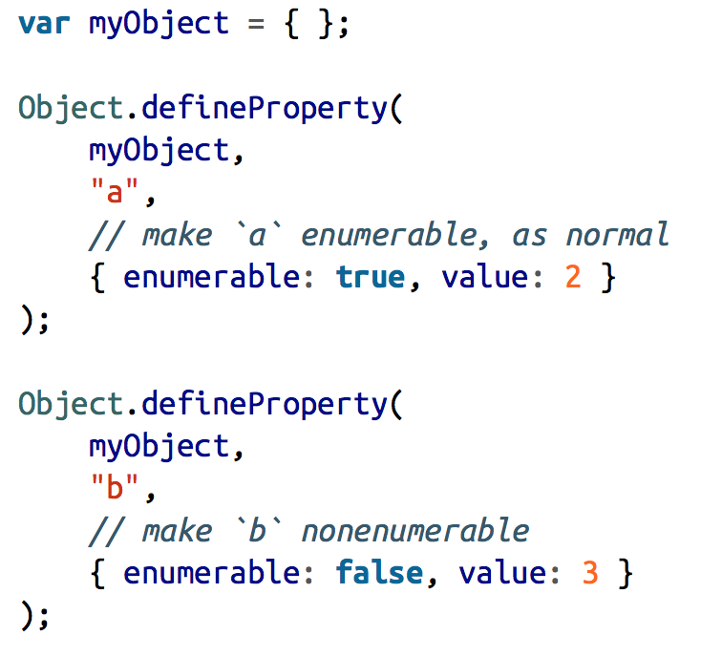
Enumerable
Let’s say that we have this object:

Slide 41
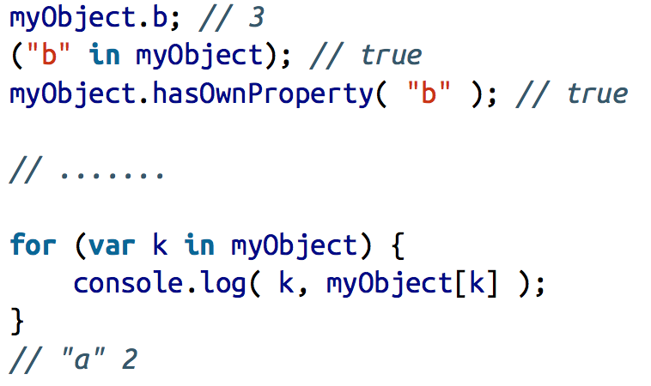
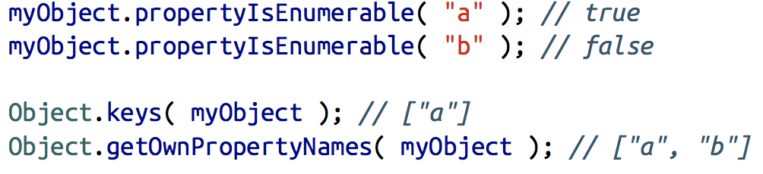
Enumerable
Let’s make some experiments:

Slide 42
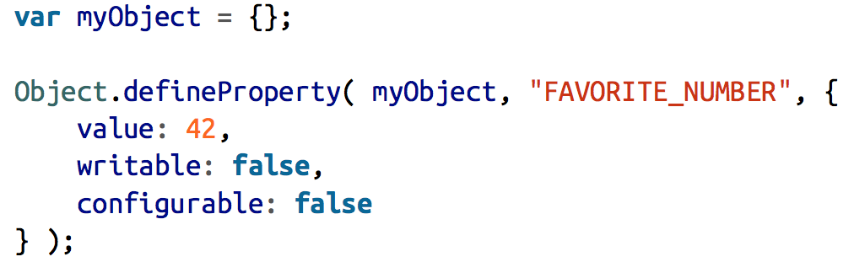
Immutable – Object constants
By combining writable:false and configurable:false, you can essentially create a constant (cannot be changed, redefined, or deleted) as an object property, like:

Slide 43
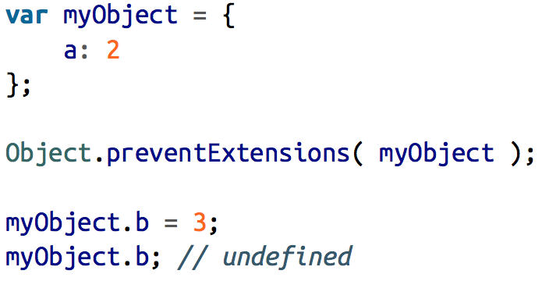
Immutable – Prevent extension
If you want to prevent an object from having new properties added to it, but otherwise leave the rest of the object’s properties alone, call Object.preventExtensions(..):

Slide 44
Immutable – seal and Freeze
Object.seal(..) creates a “sealed” object, which means it takes an existing object and essentially calls Object.preventExtensions(..) on it, but also marks all its existing properties as configurable:false.
So, not only can you not add any more properties, but you also cannot reconfigure or delete any existing properties (though you can still modify their values).
Object.freeze(..) creates a frozen object, which means it takes an existing object and essentially calls Object.seal(..) on it, but it also marks all “data accessor” properties as writable:false, so that their values cannot be changed.

Slide 46
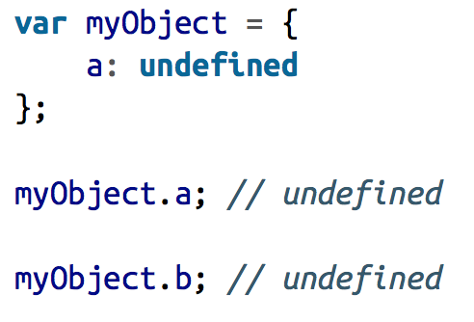
[[GET]]
What’s the difference between ‘a’ and ‘b’ property?

Slide 47
[[PUT]] – not so simple
Is the property an accessor (setter) descriptor? If so, call the setter, if any.
Is the property a data descriptor with writable of false? If so, silently fail in non-strict mode, or throw TypeError in strict mode.
Otherwise, set the value to the existing property as normal.
If the property is not yet present on the object in question, the [[Put]] operation is even more nuanced and complex, and this invokes prototype.

Slide 48
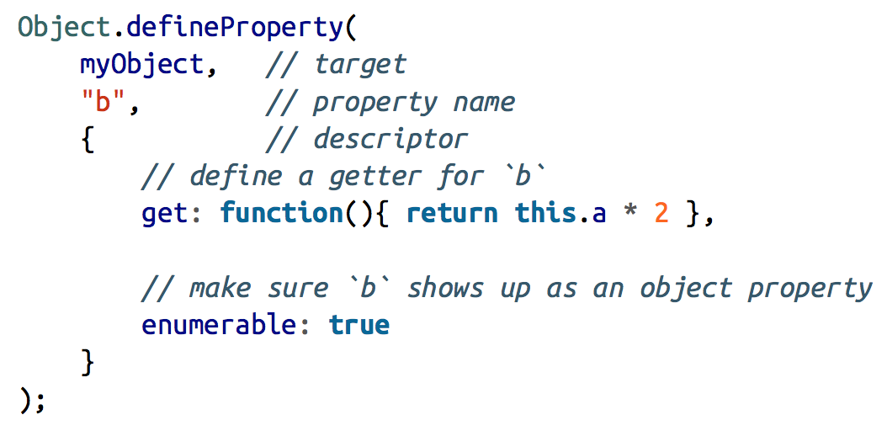
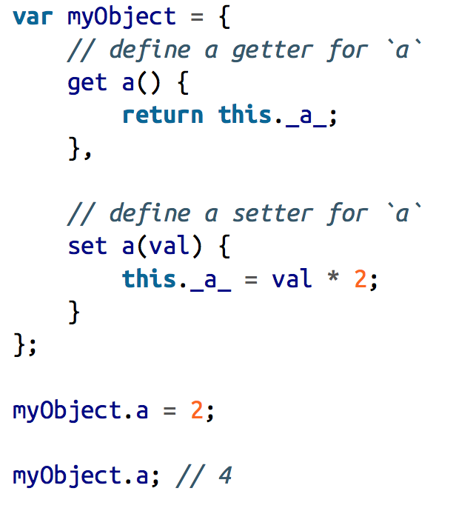
ES5 Setters and Getters

Slide 49
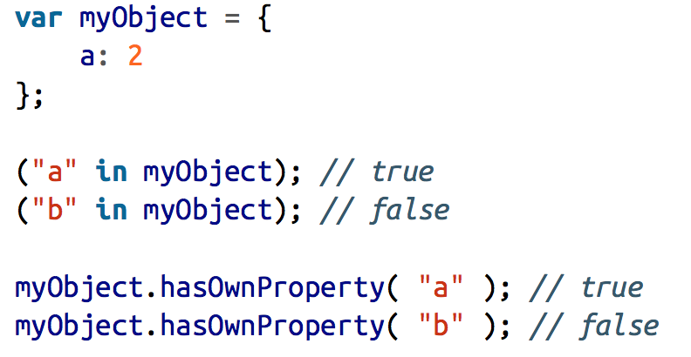
Existence
What’s the difference?

Slide 50
Home work
Implement a Module named Garage that will manage .. Your garage exposing only some public methods
You will have there a massive with all the car infos that will be private
Implement sorting, filtering methods for this module
Implement an Iterator for Garage module that will iterate through all cars

